Slide 1
Mexico timeline
By Andres castro

Slide 2
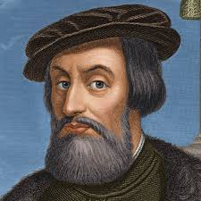
1521
Hernán Cortés defeated the Aztec Empire. He was able to take the land and claim it for Spain
http://www.biography.com/people/hern%C3%A1n-cort%C3%A9s-9258320#later-years

Slide 3
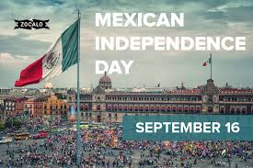
1810-1821
Mexico fought Spain in order to become independent. The war dragged on for about 11 years with Mexico finally being established as independent on September 16th, 1821
http://www.history.com/topics/mexico/struggle-for-mexican-independence

Slide 4
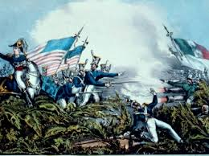
1846-1848
The Mexican-American war kicked off, the result ended up with Mexico losing what is now current day California, Utah, Nevada, Arizona and New Mexico.
http://www.history.com/topics/mexican-american-war

Slide 5
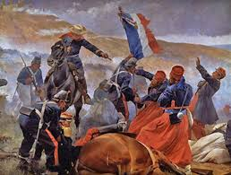
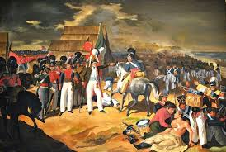
1862
Battle known as the “Battle of Puebla” because it was fought in Puebla, Mexico was when French Forces tried to establish a state in Mexico.
Mexico won the battle and it is celebrated as Cinco de Mayo
Often misinterpreted as Mexico Independence Day
http://www.britannica.com/event/Battle-of-Puebla

Slide 6
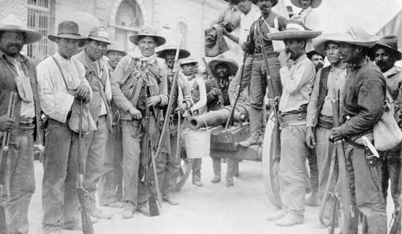
1910
The start of the Mexican Revolution
The goal was to overthrow the current ruler and dictator Porfirio Díaz Mori.
http://www.pbs.org/opb/historydetectives/feature/mexican-revolution/

