Slide 1
Olmec civilization Timeline
Andres Castro

Slide 2
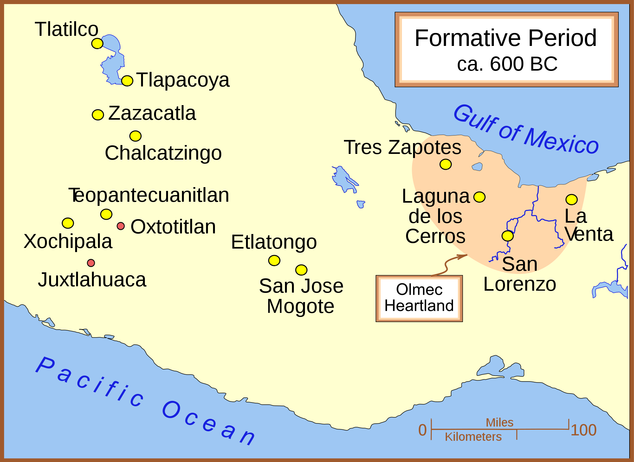
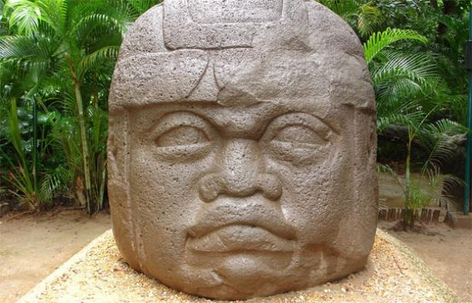
1200 B.C.
Olmec civilization begins to appear. They settled by the Gulf of Mexico because of the fertile soil, which made crops easier to grow.

Slide 3
1200 B.C.
San Lorenzo became the main centre.
The way it was positioned kept it safe from flooding.

Slide 4
900 B.C.
San Lorenzo was destroyed because of systematic destruction.

Slide 5
900 B.C.
La Venta became the Olmec civilization Capital.
It supported a population of around 18,000 people

Slide 6
300-400 B.C.
Olmec Civilization ended.
Monuments were defaced and evidence of systematic destruction is led to believe to have ended the civilization.

Slide 7
References
Ancient Origins. (n.d.). Retrieved September 22, 2015.
Cartwright, M. (2013, August 30). Olmec Civilization. Retrieved September 22, 2015.
(n.d.). Retrieved September 22, 2015, from http://en.wikipedia.org/wiki/Main_Page

